Slide 1
The Civil War – A House Divided
“A house divided against itself cannot stand. I believe this government cannot endure, permanently half slave and half free. I do not expect the Union to be dissolved—I do not expect the house to fall—but I do expect it will cease to be divided. It will become all one thing or all the other.”
~Abraham Lincoln, 1858, during a Senate campaign speech

Slide 2
The U.S. Civil War
1861-1865
North
South
United States of America
Union
Blue
Yankees
Pres. Abraham Lincoln
Washington , D.C.
Gen. Ulysses Grant
Confederate States of America
Confederacy
Gray
Rebels
Pres. Jefferson Davis
Richmond, VA -Montgomery Alabama
Gen. Robert E. Lee

Slide 3
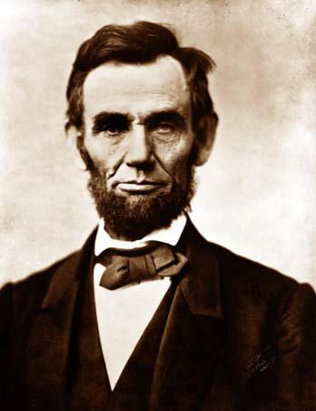
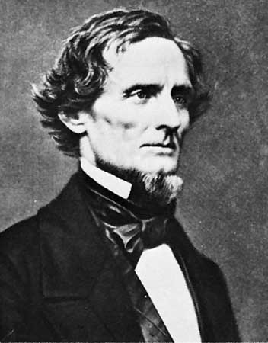
Presidents
Lincoln
Davis

Slide 4
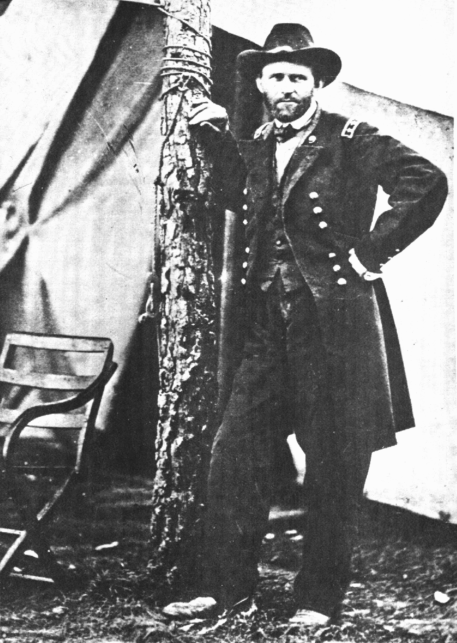
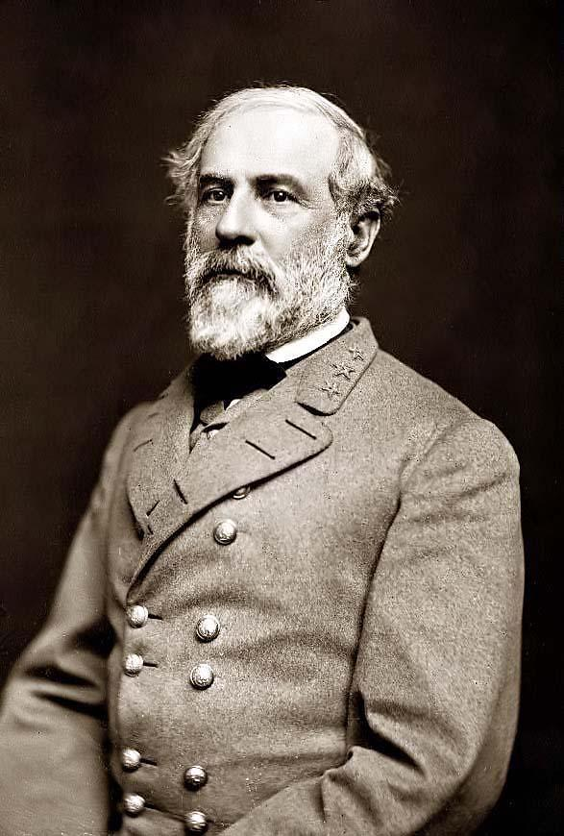
Generals
Grant
Lee

Slide 5
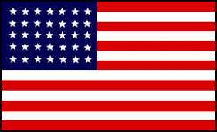
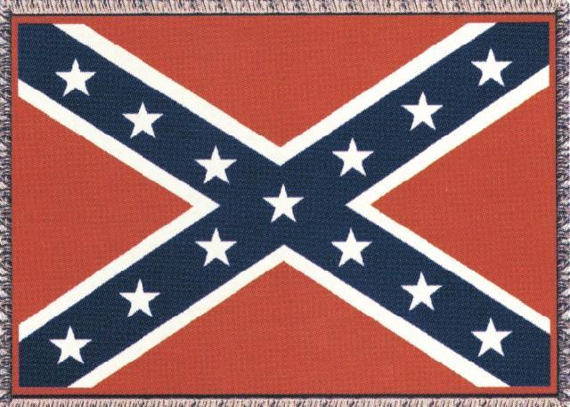
Nation’s Flags

Slide 6
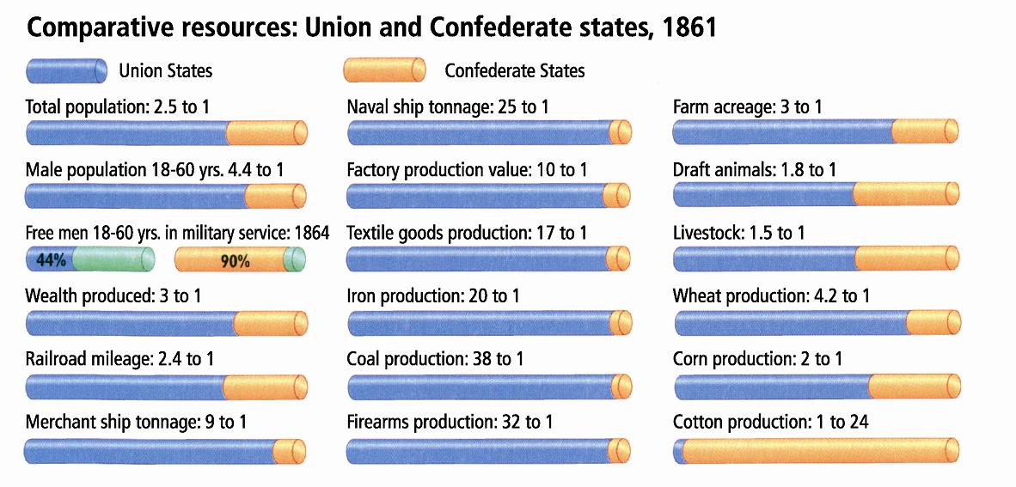

Slide 7
Were there any advantages for the South?
Defending their homes and way of life
Better Generals and Officers

Slide 8
Major Battles
April 12, 1861-The Civil War begins when Confederate troops bombed Ft. Sumter. S.C.
Most Battles were in the South
Many had 2 names North named battles after closest physical feature-South after closest town
1st battle-Manassas/Bull Run, VA- July, 21 1861- Confederates Win! Meaning?
Casualties-Union 2,900 Confed. 2,000

Slide 9
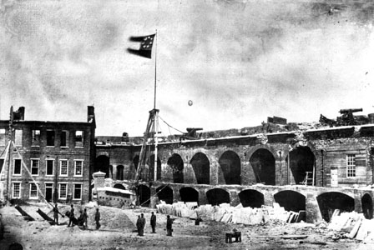

Slide 10
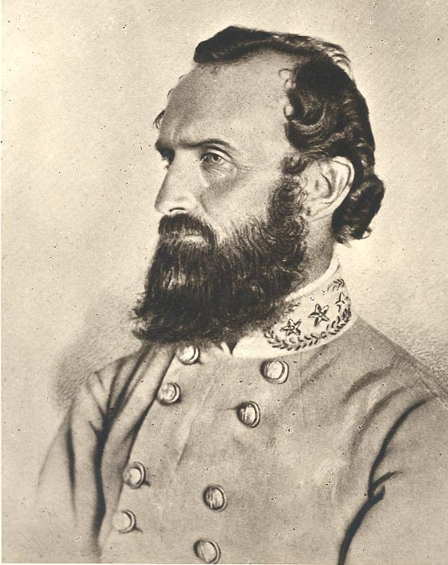
Thomas “Stonewall” Jackson

Slide 11
The Battle of Antietam
Sept. 17, 1862-Maryland-Lee attacked Union
40,000 Confederates vs. 75,000 Union troops
12,000 casualties in 1st 3 hours
Union victory
Casualties- Confed. 14,000 Union 12,000
THE BLOODIEST SINGLE DAY BATTLE

Slide 12
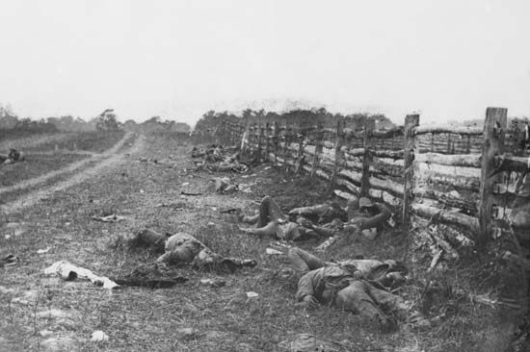

Slide 13
The Battle of Gettysburg
July 1,2,3 1863-Union Victory-
Turning Point Battle-?
Last time South invades North
50,000+ combined casualties-most!
November 1863-Gettysburg Address

Slide 14
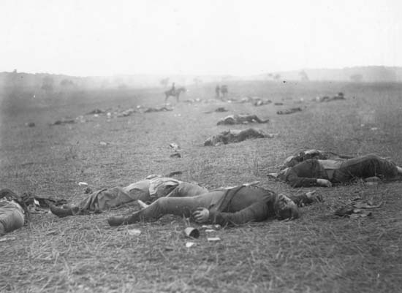

Slide 15
The Battle of Vicksburg
On the same weekend the Union won the Battle of Gettysburg they also won in Vicksburg
Allowing the Union to control the Mississippi River
This signaled the beginning of the end for the Confederacy

Slide 16
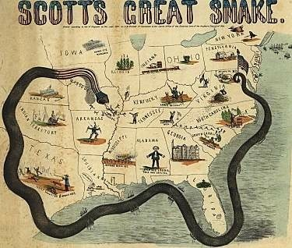

Slide 17
POW Camps
POW’s were treated horribly by both sides.
The most notorious was Andersonville, Ga.
Built to hold 10,000 it would eventually hold 35,000
About 100 prisoners a day died, usually of exposure or starvation.

Slide 18
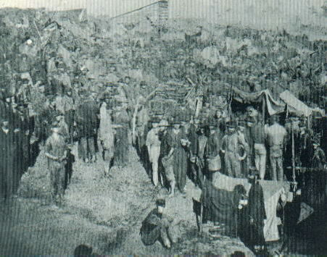

Slide 19
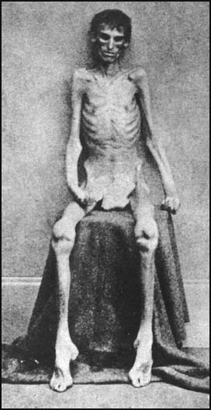

Slide 20

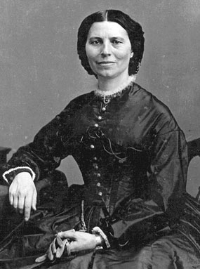
Clara Barton
Angel of the Battlefield

Slide 21
Lincoln and The Constitution
Constitution
Lincoln’s Action
Congress has power to raise and support armies
No $$ can be taken from treasury w/out approval
Writ of H.C. not suspended unless rebellion
No law taking away free speech
Right to fair speedy trial
Increased size of army w/out Congress approval
Withdrew $2m for military w/out approval
Arrested+jailed anti-unionists giving no reason
Censored newspapers
Anti-unionists given military trials-less evidence to convict

Slide 22
Lincoln during the Civil War
His oath of office stated he was to
Preserve the Union
Told Southern leaders USA was nation of people not states
In order to prevent the British from supporting the South Lincoln “frees” slaves in “rebelling areas” Emancipation Proclamation
These slaves were not under his control, but made the war’s purpose to end slavery.
Britain had outlawed slavery in 1836.

Slide 23
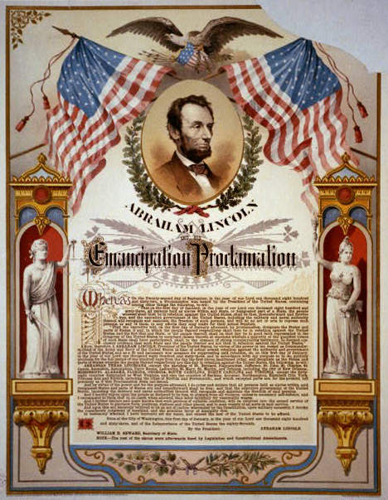

Slide 24
The War Ends
Lee surrenders to Grant at Appomattox Court House, Va. April 9, 1865.
ENDING THE WAR!
THE UNION WON!
Lincoln is shot by John Wilkes Booth April 14, 1865 and dies the next day.
$20 Billion cost
The Federal Government supreme to States
The USA is unified???
13th Amendment ends Slavery

Slide 25
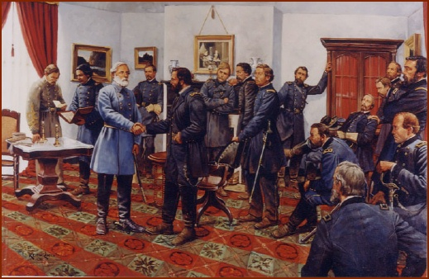

Slide 26
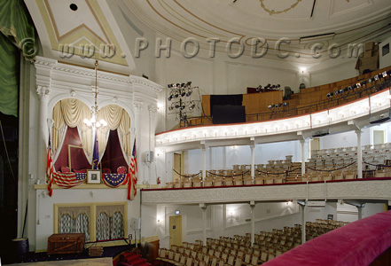

Slide 27
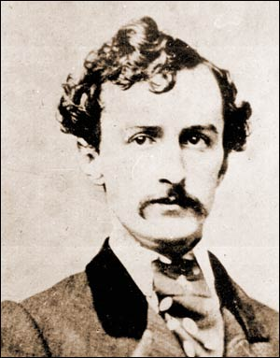

Slide 28
Casualties
Killed and Mortally Wounded
Union-110,000 Confed.-94,000=204,000
Dead of Disease-Union-225,000 Confed.165,000=390,000
POW’sDead-Union-30,000 Confed.-31,000=61,000
Wounded-Union-275,000 Confed. 194,000=469,000
Total Casualties-Union-640,000 Confed.-484,000

